Slide 1
Current status for establishing Lao Education & Research Network (LERNET)
Prepared By: Kheuangkham Phothisan
IT Center, NUOL

Slide 2
Agenda
About Laos
About NUOL / LERNET
Current Situation for establishing connection from LERNET to TEIN (via UniNET)

Slide 3
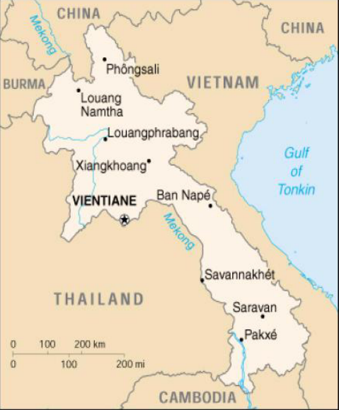
About Laos
Country Name Lao People's Democratic Republic
Area 236,800 Km²
Capital City Vientiane Capital
Population 6.5 Millions
Official language Lao language
Currency LAK / Kip (1 US$ = 7820 Kip)
Time Zone UTC +7
Calling code +856
ccTLD la
PSTN 3 Operators (LTC, ETL, STL)
Mobile 4 Operators (LTC, ETL, STL, VCL)
ISPs 6 ISPs (ETL,LTC,STL,VCL,SkyTel,Planet )

Slide 4
Operator and ISPs in Laos
Name | Describe
Lao Telecom Co (LTC) | Established in 1996 Lao Government 51% and Thaicom (Thailand) 49%
ETL Public Company (Enterprise Telecom Lao) | Re-established in 2000 State-owned company, Lao Government 100% ETL will sell first 30% IPO on November 2011 (delay), Government will continue to hold 70%.
Star Telecom Lao (STL) | Established in 2008 Lao Asia Telecom 51% and Viettel Global (Vietnam) 49% Started the new brand “Unitel” on October 2009.
VimpelCom Lao (Beeline) (VCL) | Established in 2003, (re-established in 2011) Lao Government 22% and VimpelCom 78% VimpelCom (Russia) bought 78% shares from Millicom International Cellular (MIC) on March 2011
Planet Online | Established in 1997, Lao Private Company
Sky Telecom | Established in 2005 Lao Government 30% and Sky Telecom Thailand 70% Sky Telecom Thailand withdraw the investment in beginning of 2011, and now restructuring under Ministry of Defense (MOD)
Ref.: LANIC, Lao National Internet Center, lanic.la

Slide 5
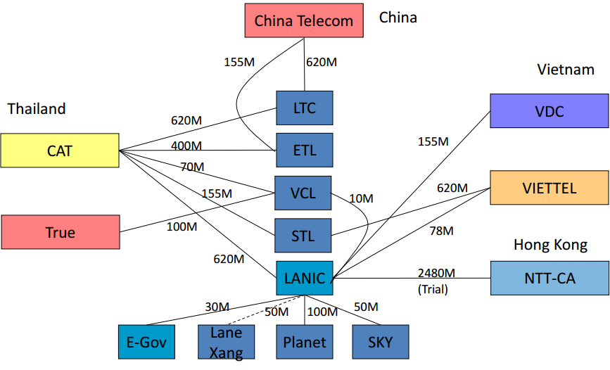
Current Laos internet Connection
Ref.: LANIC, Lao National Internet Center, lanic.la

Slide 6
About NUOL
NUOL, National University Of Laos provides the internet connection, network infrastructure and application services.
IP Block: 180.131.148.0 - 180.131.151.255 (/22) - APNIC
AS Number: AS45906 - APNIC
Current Connections: 4 ISPs
ETL- 2mbps
LTC- 2mbps
BeeLine- 2mbps
Unitel – 4 mbps
Plan to establish LERNET
Plan to connect the LERNET to TEIN with bandwidth 10 mbps

Slide 7
NUOL’s Network Diagram

Slide 8
Current Status about Connection Plan
There are two options:
Option1: CAT- LANIC – NUOL
From KKU in Nongkhai to Thanaleng, Vientiane, they have fiber belong to Thai Rail Way Ministry that CAT uses to connect to LANIC and then LANIC has their own connection from Thanaleng to LANIC office. So from LANIC to NUOL we will use Sky Tel to connect it
2. Option2: CAT – SkyTel – NUOL
CAT has connection to Skytel with 2.5 GB but Sky Tel suggest to use new 2 core fiber from middle bridge to LANIC and LANIC to NUOL.
We have setup the technical team to work with NSRC for the network equipment/design and connections.
Mailing list: lernettechteam@nuol.edu.la
Notes:
According to the VC discussion, Thai side will review their existing connection and talk to Sky and LANIC then they will let us know. We expect to test the connection by the end of December
Right now we also work with NSRC in terms of selection and designing the network and equipment.

Slide 9
LERNET to TEIN via uninet
UniNET at Khon Kaen University (Nongkhai Campus) installs the transmission link to CAT Telecom (Nongkhai Office)
From CAT Telecom (Nongkhai Office), UniNET leases the transmission link from CAT Telecom to connect with LANIC.
LANIC and GTPA provides the transmission link for NUOL to connect with UniNET .
LERNET will connect with TEIN3 via UniNET.
GTPA = Government Telecommunication Project Agency, Sky Telecom

Slide 10
Network Connection Plan - Overview

Slide 11
Connection Plan
LERNET plans to connect to TEIN via UniNET (10 mbps)
LERNET establishes the links to
Ministry of Education and Sport (MoES) by using the GTPA fiber optic
UniNET via Sky Telecom which ISP is connected to LANIC
NUOL (National University of Laos)
Other research and education institutions

Slide 12
New Network Diagram Expected at University

Slide 13
Thank you for your attention
Have a nice day !

